Slide 1

Alec Knowles, MASc Candidate
Yunlei Zhang, MEng Candidate
Yue Yu, MEng Candidate
8 April 2015 / ECE 1778

Slide 2


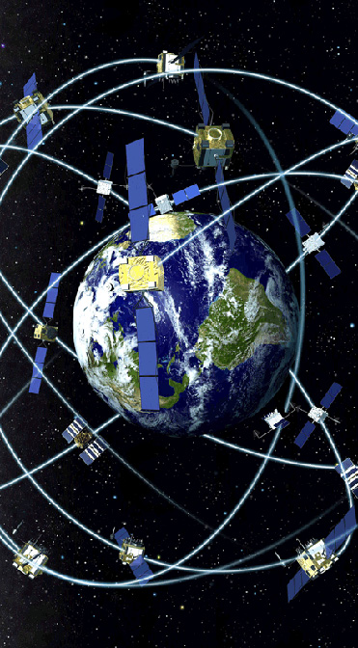
Don’t Stop
Mobile app for use:
collect field data
buses
by to on
transit agencies
}
key performance indicators

Slide 3
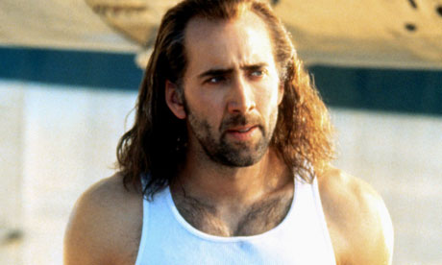

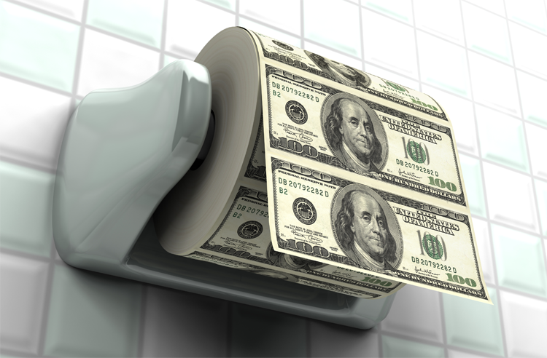




Motivation Design Demo Learning Future
=
(etc.)
Notes:
Motivation:
Full buses, empty buses, late buses (pictures)
Garbage in, garbage out (picture)
Goal:
Use field data to validate results of existing desktop route analysis software which allows users to predict effects of adding/deleting stops
Improve the quality of data available to transit agencies for data analytics

Slide 4
Motivation Design Demo Learning Future
Goals
Alec’s thesis:
Desktop route analysis software → key performance indicators to improve transit efficiency
App:
Gather and use field data to validate results of desktop software
Improve the quality of data available to transit agencies for data analytics
Notes:
Motivation:
Full buses, empty buses, late buses (pictures)
Garbage in, garbage out (picture)
Goal:
Use field data to validate results of existing desktop route analysis software which allows users to predict effects of adding/deleting stops
Improve the quality of data available to transit agencies for data analytics

Slide 5
Motivation Design Demo Learning Future
How it works
Historical Data
Bus Equipment
Existing Desktop Software
Mobile App
Real-time GPS and Speed Data
Mobile Device
Data Cleaning Algorithm

Slide 6
Motivation Design Demo Learning Future
Input – filters for historical data (date, time) and route of interest
Google Maps plot of existing stops
Real-time speed plot while data is collected
Results – bus dwell times, avg. trip speed, etc.
Notes:
Return route-specific data from server to stops in Google Maps
Determine true dwell times at stops from gathered data

Slide 7
Motivation Design Demo Learning Future
Demo

Slide 8
Motivation Design Demo Learning Future
Accuracy of data is paramount
Not as easy as saying “Sensor, collect data!”
Spend more time programming data collection
Ensure data consistency
Get a small number of key tasks right, rather than a large number of tasks half-right
Android: some hard things are easy, and some easy things are hard

Slide 9
Motivation Design Demo Learning Future
Make existing desktop tool controllable via mobile, and app controllable via desktop
Additional performance indicators
Average user time/distance on bus
On-time performance of bus
More automation
App automatically detects route, automatically starts and stops, etc.
Notes:
- So desktop software can be run from phone when on site or in a meeting, and mobile software can be run by someone in an office, while the phone is simply installed on a bus.

Slide 10
References
http://torontoist.com/2010/12/2010_hero_ttc/
http://www.extremetech.com/wp-content/uploads/2012/04/gps-satellite-constellation.jpg
http://www.lakedistrictonboard.com/bus1.jpg
https://programsuccess.files.wordpress.com/2011/09/performance_indicator.jpg
http://static.guim.co.uk/sys-images/Guardian/Pix/pictures/2011/2/16/1297864081731/Nicholas-Cage-007.jpg
http://www.sinemafilm.org/wp-content/uploads/Buyuk-Hazine-National-Treasure-2004-poster-afis.jpg
https://fridaynightfilmfights.files.wordpress.com/2013/06/cage-match.jpg?w=684
http://upload.wikimedia.org/wikipedia/en/c/c5/Left_Behind_-_Teaser_Poster.jpg
http://schmoesknow.com/wp-content/uploads/2011/01/season_of_the_witch_1_2009.jpg

Slide 11
Thanks

